Slide 1
The Futures of Pastoralism in Africa Presentation to the European Parliament, Brussels, 1st March 2012 Andy Catley Africa Regional Office - Tufts University Addis Ababa Ethiopia

Slide 2
“Pastoralism is dead in Africa – these droughts and conflicts are the final nails in the coffin for this antiquated way of life.”
“Pastoralists in the Horn alone are trading livestock valued at about US$1 billion a year. This is an incredibly robust system that keeps growing”

Slide 3
Good rangeland access/mobility
High market access |  | Low market access
Poor rangeland access/low mobility
Future
= commercialization and trade, domestic + export
= continued use of mobile livestock production systems
Future
= “traditional” pastoralism and mobility
Future
= added value on livestock products
= diversification
Future
= exits and protracted destitution for some
= alternative livelihoods for others

Slide 4
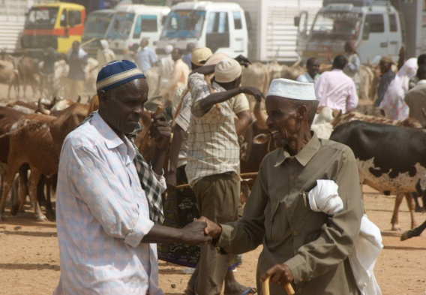
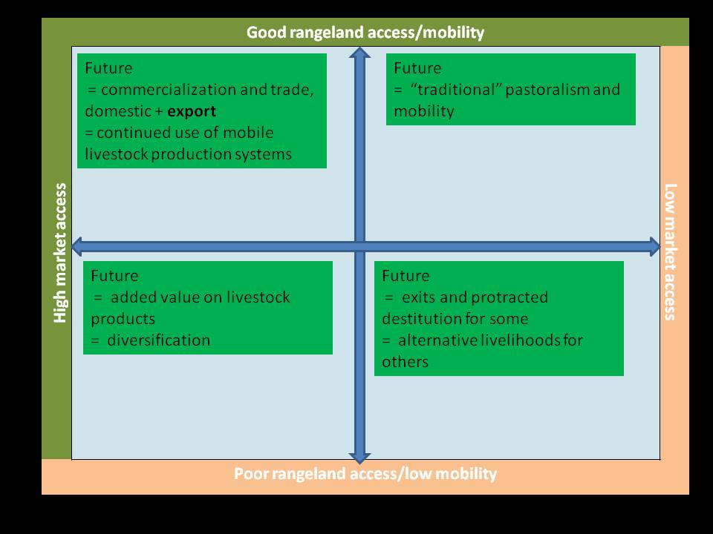
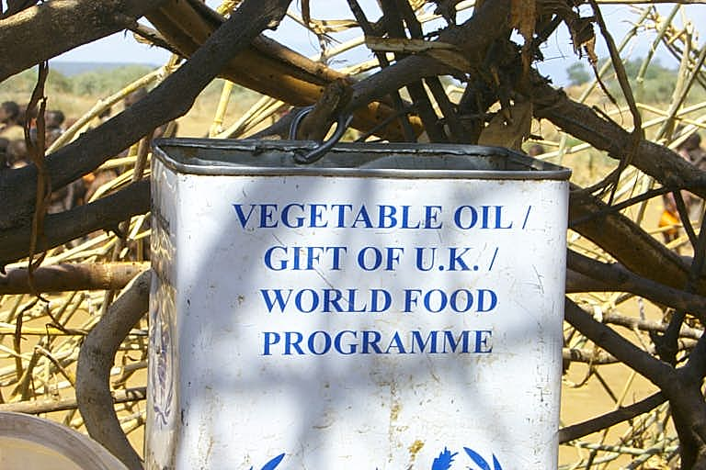
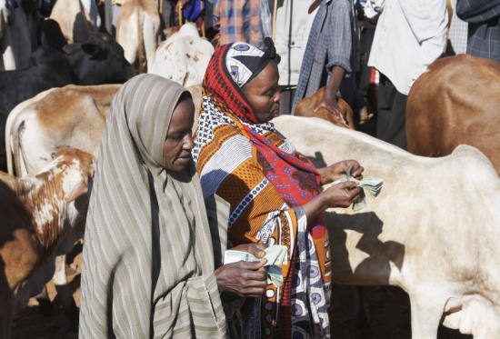
Example: Somali Region, Ethiopia
Wealthy pastoralists “Moving Up”
“Traditional” pastoralists
~1920s
Population growth
Drought
Weak governance
Conflict
Poor pastoralists “Moving Out”
Peri-urban

Slide 5
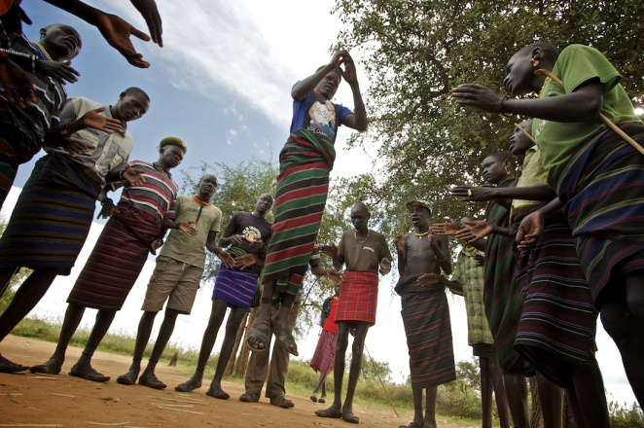
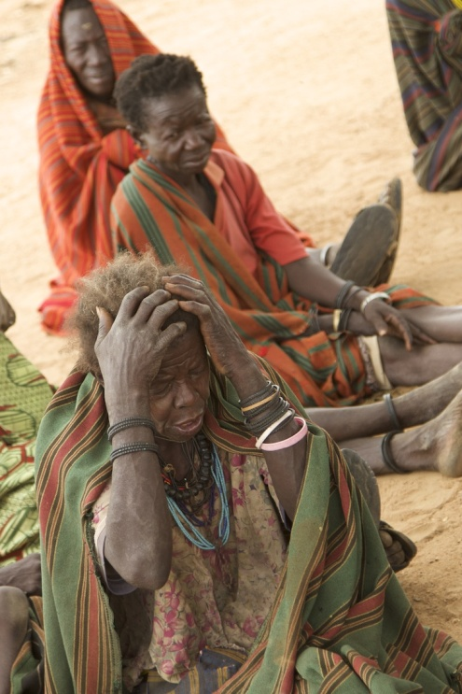
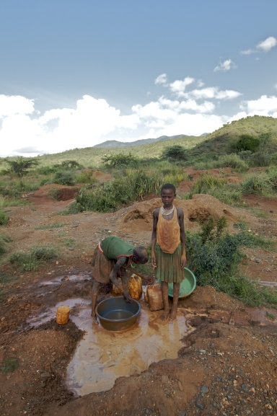
Example: Karamoja, Uganda
“Traditional” pastoralists
State-imposed immobility
Population growth
Drought
Inappropriate aid
Poor pastoralists “Moving Out”

Slide 6
Futures Not Future
Many different futures
Within the same area, diverse trends are evident
Those people “Moving Up” have good rangeland access, mobility and market access – and larger herds
Those “Moving Out” have declining rangeland access, reduced mobility and low market access – and smaller herds
Position the key drivers of change - human population growth, commercialization and rangeland access (land grabbing) against the “constants” viz. weak governance, conflict and marked climatic variability

Slide 7
History lessons
Agricultural development globally characterized by absorption of small units by large units during commercialization
Commercialization and pastoralism (Middle East etc.)
Growth of industries (oil) and urban centers, with growing demand for meat and milk
Pastoral commercialization
Social and economic isolation of poorer households
Outmigration for the poor, who are forced out
Pastoralism survives, but in a more commercialized form, with relative fewer but larger herds

Slide 8
EU Aid Responses
1. Align new EU programs with the African Union Policy Framework for Pastoralism in Africa
AU role = normalize pro-pastoral positions in the African policy environment
Fast track aid support to Regional Economic Communities and Member States that align rapidly to the AU framework
2. A dual approach
Support different forms of pastoralism, livestock production and marketing, with related land access and mobility
Support alternative livelihoods – education is key
3. Harmonize development and humanitarian programs under a long-term drylands strategy
4. The futures are different
Ensure country-level analysis and adaptation of the above responses
Evidence and systematic participatory review of past programs – civil society
Avoid undermining
pastoralism and mobility

Slide 9
Acknowledgements
The research underpinning this presentation was conducted with Yacob Aklilu under the program Understanding the Future of Pastoralism in Africa at the Feinstein International Center, Tufts University, and funded by USAID under the Pastoralist Livelihoods Initiative program in Ethiopia, and Ukaid via the Department for International Development. Further information is available at http://sites.tufts.edu/feinstein/research/the-future-of-pastoralism
The framework used in slides 3-5 was drawn from the presentation by Ian Scoones at the conference The Future of Pastoralism in Africa, held in Addis Ababa in March 2011, and organized by the Future Agricultures Consortium and Tufts University. Further information is available at http://www.future-agricultures.org/events/future-of-pastoralism
Karamoja photographs – Khristopher Carlson.

